Slide 1
Requirements: Library App
A Book Recommendation and Collection Service
Groups Members: Luke Bushur, Sean Tierney, Dylan Hasty, Jason McVey, Adam Hughes
Notes:
Luke

Slide 2
Project Overview
User registration and login.
Search for books and display results by utilizing external API
Keep an online collection of books, containing information about author(s), publisher, genre, etc.
Add/delete books to/from the collection.
Receive personalized book recommendations through OpenAI API.
Notes:
Dylan

Slide 3
Must-Have Functional Requirements
Registration/Login Page
Form with HTTP POST request
Email
Password
Confirm password (for registration)
Forgot Password
Notes:
Dylan

Slide 4
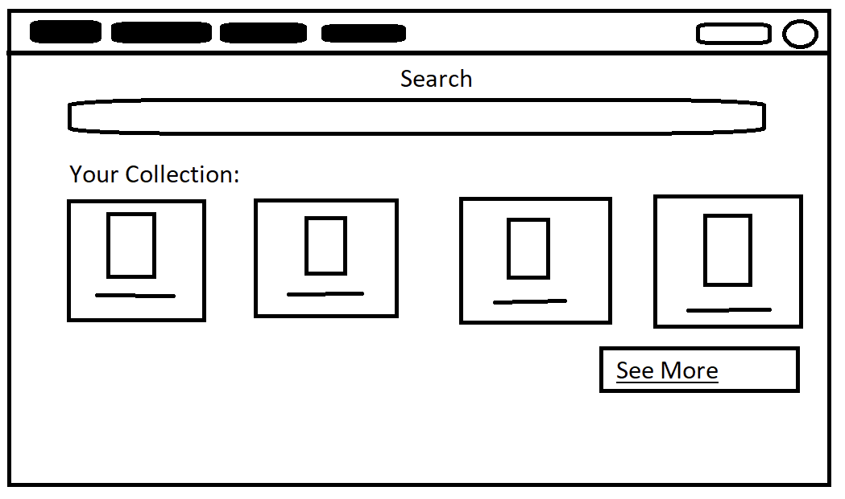
Must-Have Functional Requirements (cont.)
Homepage
Top navigation bar: Home, search, collection, recommendations
Search bar
Search by title, author, ISBN
Collection preview
Display several books in the user’s collection
Basic information: Cover, title
Notes:
Luke

Slide 5
Must-Have Functional Requirements (cont.)
Search Page
Search bar
Search by title, author, ISBN
Public API: openlibrary.org
List of search results
Book information: Cover, title, author
Add book to collection
Notes:
Adam

Slide 6
Must-Have Functional Requirements (cont.)
Collections Page
Displays books by cover and title
Click on books for more information, including author, publisher, genre, etc.
Ability to remove books from the collection
Notes:
Adam

Slide 7
Must-Have Functional Requirements (cont.)
Recommendations Page
Displays books by cover and title
Ability to add books to the collection
Recommendations change based on user’s collection
API: OpenAI
API Backup Plans
Deploy and run a language model, such as Llama 2, on the server
Utilize Google Bard API
Notes:
Sean

Slide 8
Optional Functional Requirements
Links to take the user to an Amazon page or a Barnes & Noble page.
Functionality to add and remove books to a wishlist.
Ability to choose which books in the collection the AI will use to make recommendations
Allow the user to filter books in the collection
Login page security questions
Two-factor authentication/multi-factor authentication
Notes:
Sean

Slide 9
Must-Have Non-Functional Requirements
Security - Password hashing/encryption, POST requests for confidentiality
Accuracy - Accurate personalized user recommendations
Validate recommendations using OpenLibrary’s search API
UX Efficiency - No wasted/unused UI elements
Reliability - Collection data is persistent
Accessibility - Users with disabilities are able to utilize this service
Aesthetic UI - Pleasant to view
Notes:
Jason

Slide 10
Optional Non-Functional Requirements
Load times - Pages load efficiently
Speed - Swift response time of search requests
Compatibility - The application works on every browser
Enjoyable UX - The web application is easy to use and navigate
Notes:
Jason

Slide 11
Thank you! Any Questions?
Notes:
Jason

